Slide 1
Chapter Outline
Inductors
Basic Structure
Inductance Equations
Parasitic Capacitance
Loss Mechanisms
Inductor Modeling
Inductor Structures
Symmetric Inductors
Effect of Ground Shield
Stacked Spirals
Transformers
Structures
Effect of Coupling Capacitance
Transformer Modeling
Varactors
PN Junctions
MOS Varactors
Varactor Modeling
CH 7 Passive Devices

Slide 2
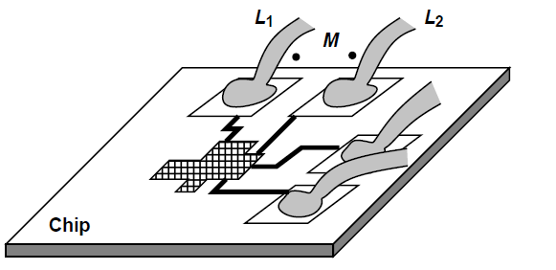
Motivation for On-Chip Integrated Inductors
Reduction of off chip components ---> Reduction of system cost.
Modeling issues of off-chip inductors
The bond wires and package pins connecting chip to outside world may experience significant coupling
CH 7 Passive Devices

Slide 3
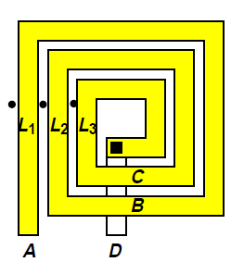
Basic Inductor Structure
Has mutual coupling between every two turns.
Larger inductance than straight wire.
Spiral is implemented on top metal layer to minimize parasitic resistance and capacitance.
CH 7 Passive Devices

Slide 4

Inductance of N Turn Spiral Structure
Inductance of an N-turn planar spiral structure inductor has
terms.
Factors that limit the growth rate of an inductance of spiral inductor as function of N:
a) Due to planar geometry the inner turns have smaller size and exhibit smaller inductance.
b) The mutual coupling factor is about 0.7 for adjacent turns hence contributing to lower inductance.
CH 7 Passive Devices

Slide 5
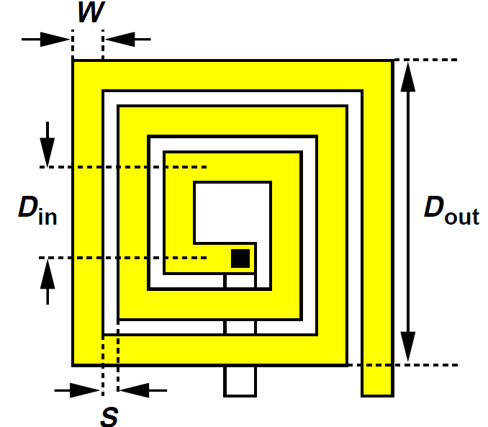
Geometry of Inductor Effects Inductance
A two dimensional square spiral inductor is fully specified by following four quantities:
a) Outer dimension, Dout
b) Line width, W
c) Line spacing, S
d) Number of turns, N
Various dimensions of
spiral inductor
CH 7 Passive Devices

Slide 6
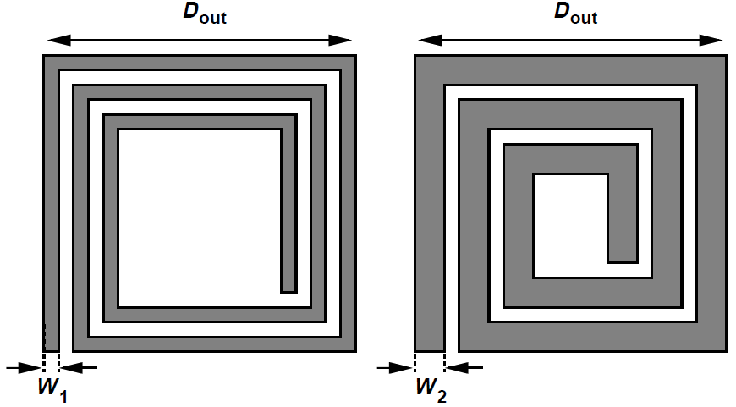
Effect of Doubling Line Width of Inductor
Effect of doubling the line width of inductor
Doubling the width inevitably decreases the diameter of inner turn, thus lowering their inductance.
The spacing between the legs reduces, hence their mutual inductance also decrease.
CH 7 Passive Devices

Slide 7
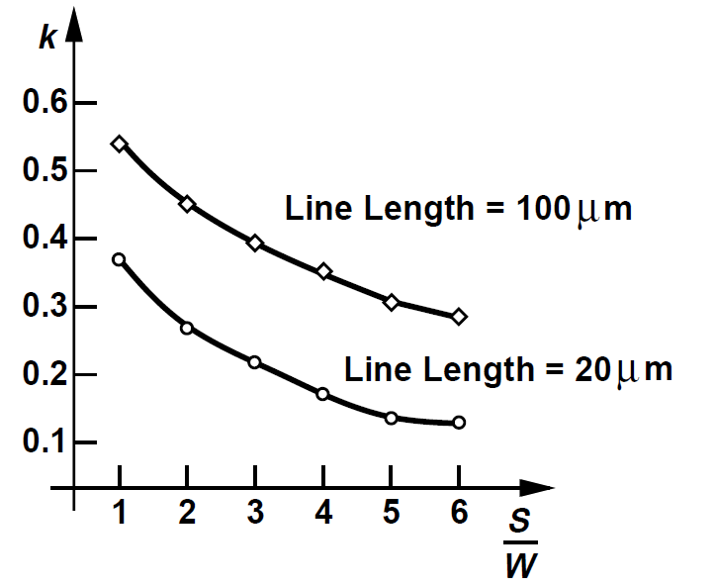
Magnetic Coupling Factor Plot
Coupling factor b/w 2 straight metal lines as a function of their normalized spacing
Obtained from electromagnetic field simulations.
CH 7 Passive Devices

Slide 8
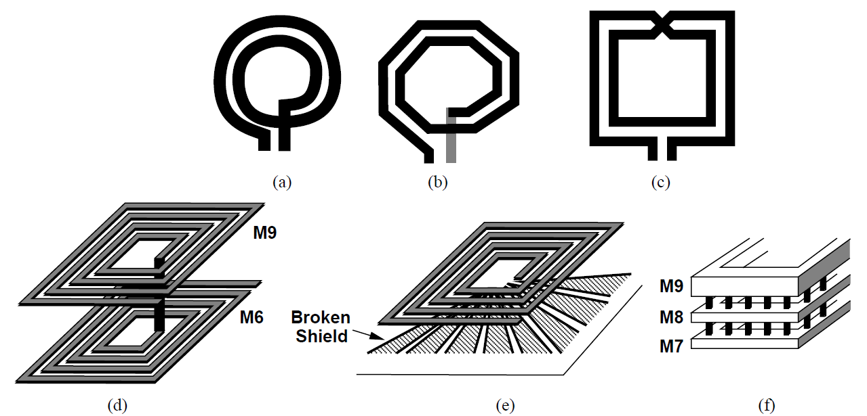
Inductor Structures Encountered in RFIC Design
Circular
Octagonal
Symmetric
Stacked
With Grounded shield
Parallel Spirals
Various inductor geometries shown above are result of improving the trade-offs in inductor design, specifically those between:
The quality factor and the capacitance.
The inductance and the dimensions.
Note → These various inductor geometries provide additional degrees of freedom but also complicate the modeling task.
CH 7 Passive Devices

Slide 9
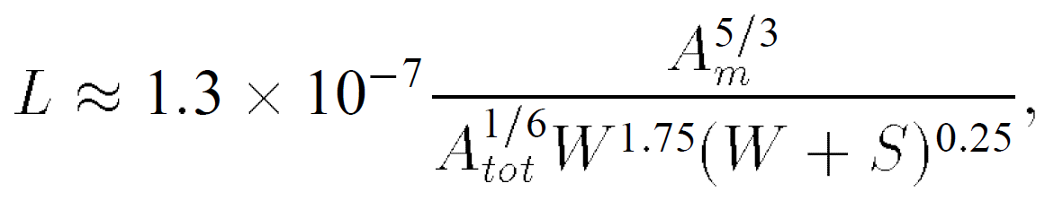
Inductance Equations
Closed form inductance equations can be found based on
1) Curve fitting methods
2) Physical properties of inductors
Various expressions have been reported in literature [1,2,3].
A_{m} – Metal area , A_{tot} – Total Inductor area
The equation above is an empirical formula which estimates inductance of 5nH to 50nH square spiral inductor within 10% error.
CH 7 Passive Devices

Slide 10
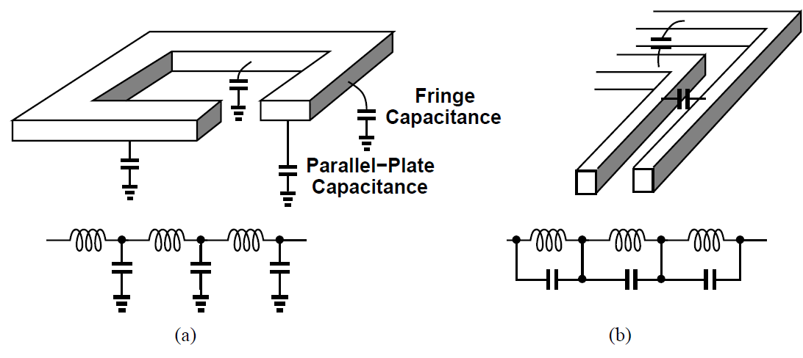
Parasitic Capacitance of Integrated Inductors
Bottom-Plate capacitance
interwinding capacitances
Planar spiral inductor suffers from parasitic capacitance because the metal lines of the inductor exhibit parallel plate capacitance and adjacent turns bear fring capacitance.
CH 7 Passive Devices

Slide 11
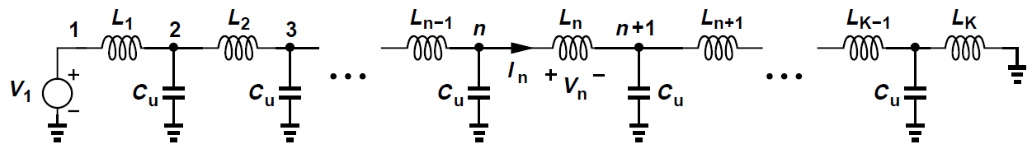
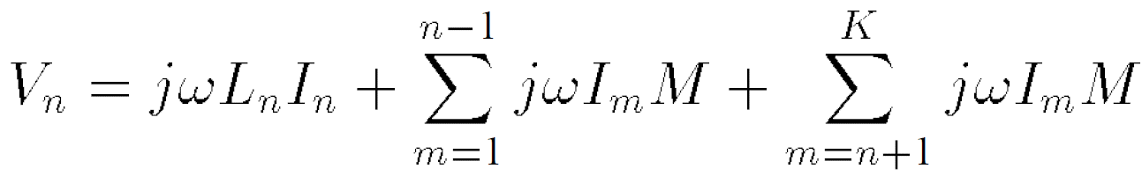
Estimation of Parasitic Capacitance
Model of inductor's distributed capacitance to ground
To simplify the analysis we make two assumptions:
1) Each two inductor segments have a mutual coupling of M
2) The coupling is strong enough that M can be assumed approximately equal to L_{u}
Voltage across each inductor segment:
CH 7 Passive Devices

Slide 12
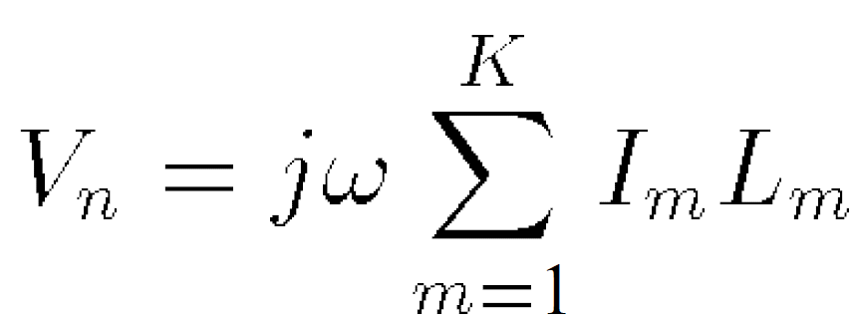
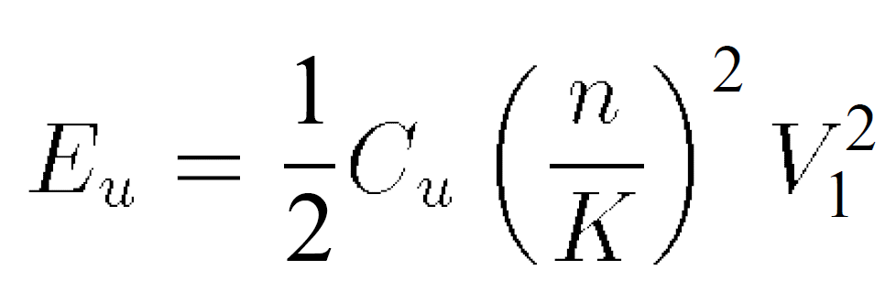
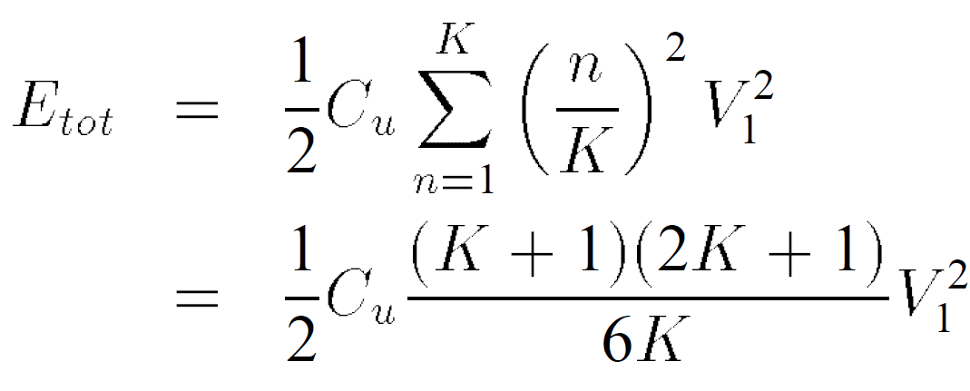
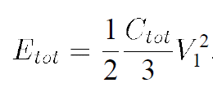
Estimation of Parasitic Capacitance
If M = L_{u ,} then
Electrical energy stored in node capacitance is:
Total energy stored on all of the unit capacitances =
If k-->infinity and C_{u}-->0 such that kC_{u} is equal to total wire capacitance:
Capacitance = C_{tot} /3
CH 7 Passive Devices

Slide 13
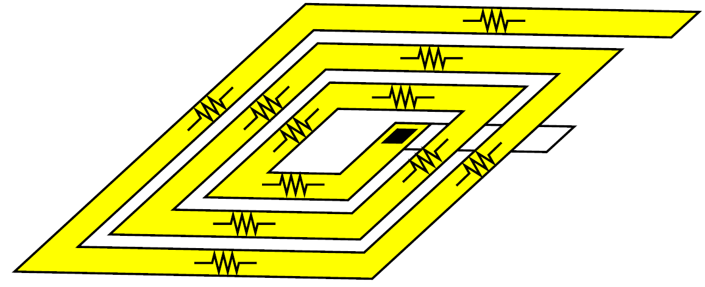
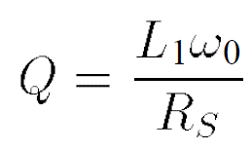
Loss Mechanisms: Metal Resistance
Metal resistance Rs of spiral inductor of inductance L1
Q = Quality factor of inductor
(measure of loss in inductor)
CH 7 Passive Devices

Slide 14
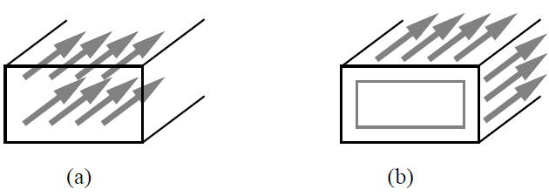
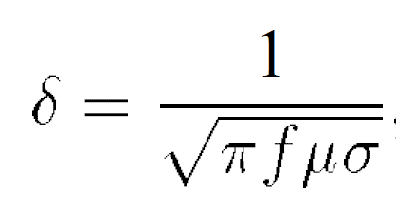
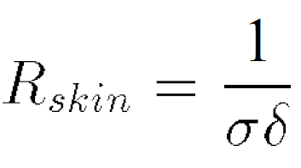
Loss Mechanisms: Skin Effect
Current distribution in a conductor at
(a) Low frequency (b) High frequency
Extra resistance =
Skin depth =
CH 7 Passive Devices

Slide 15
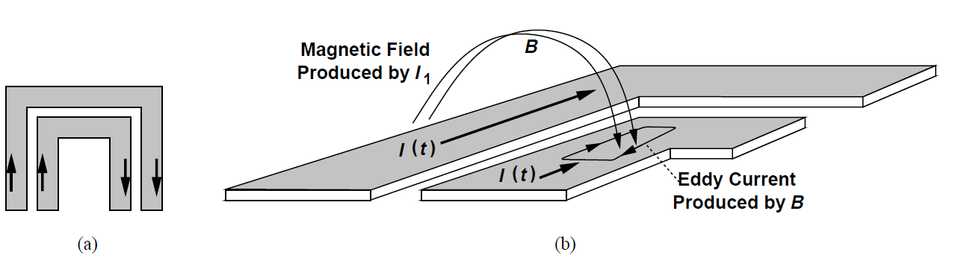
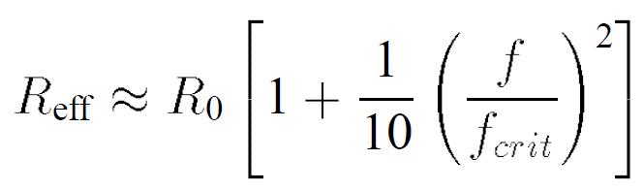
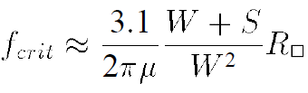
Skin Effect: Current Crowding Effect
(a) Current distribution in adjacent turns (b) Detailed view of (a)
Based on the observation in [7,8] derive the following expressions:
At f_{crit} , the magnetic field produced by adjacent turn induces
eddy current, causing unequal distribution of current across the
conductor width, hence altering the effective resistance of the turn.
CH 7 Passive Devices

Slide 16
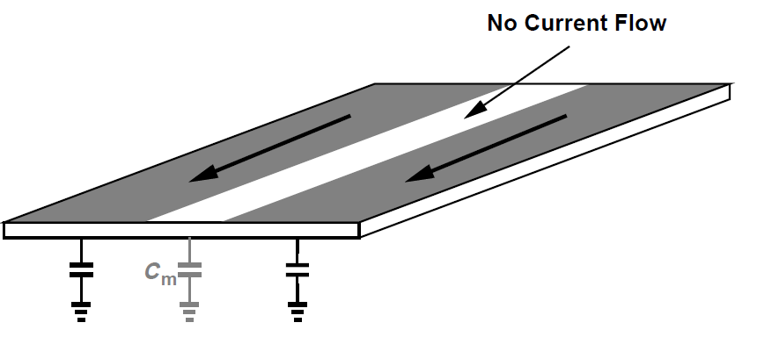
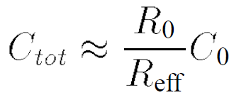
Current Crowding Effect on Parasitic Capacitance
As current flows through a smaller width of conductor, this causes a reduction in the effective area between the metal and substrate, hence there is a reduction in the total capacitance.
CH 7 Passive Devices

Slide 17
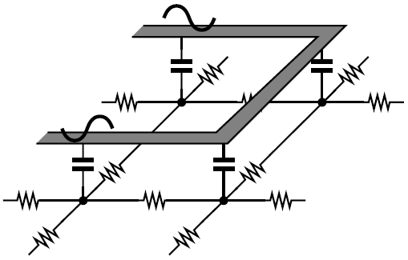
Capacitive Coupling to Substrate
Substrate loss due to capacitive coupling
Voltage at each point of the spiral rise and fall with time causing displacement current flow between this capacitance and substrate.
This current causes loss and reduces the Q of the inductor.
CH 7 Passive Devices

Slide 18
Recap of Basic Electromagnetic Laws
Ampere's Law: States that the current flowing through a conductor generates a magnetic field around the conductor.
Faraday's Law: States that a time varying magnetic field induces a voltage and hence a current, if a voltage appears across a conducting material.
Lenz's Law: States that the current induced by a magnetic field generates another magnetic field opposing the first field.
CH 7 Passive Devices

Slide 19
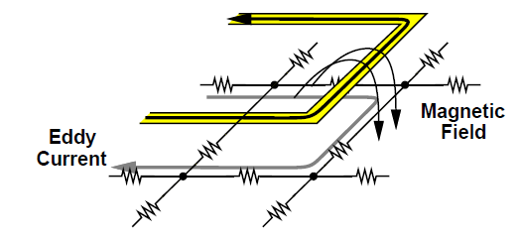
Magnetic Coupling to Substrate
The time varying inductor current generates eddy current in the substrate.
Lenz's law states that this current flows in the opposite direction.
The induction of eddy currents in the substrate can be viewed as transformer coupling.
CH 7 Passive Devices

Slide 20
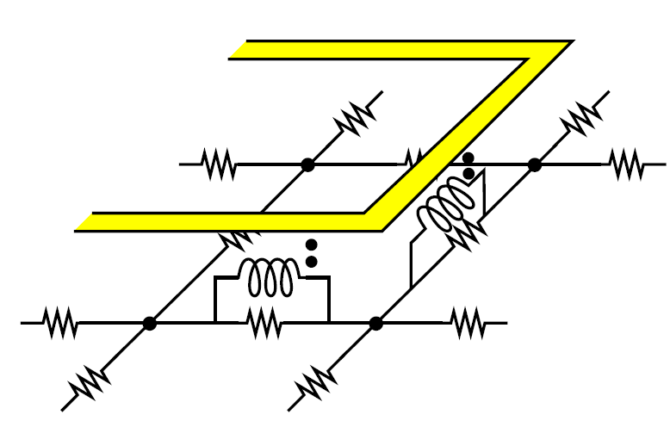
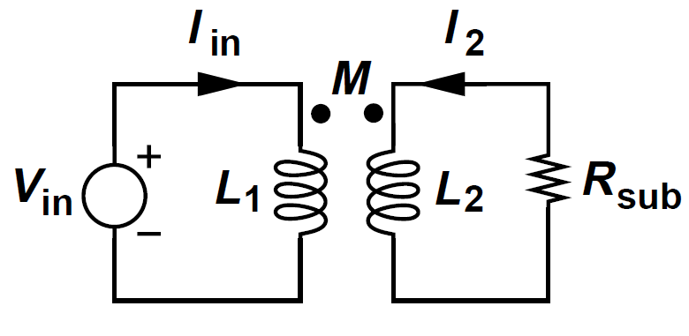
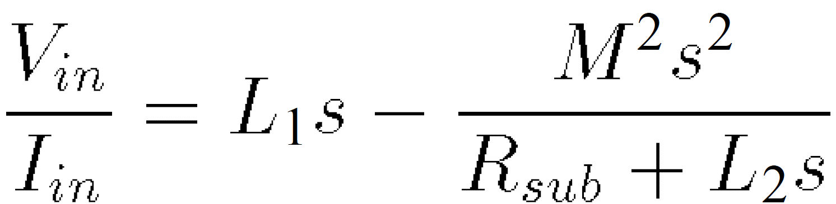
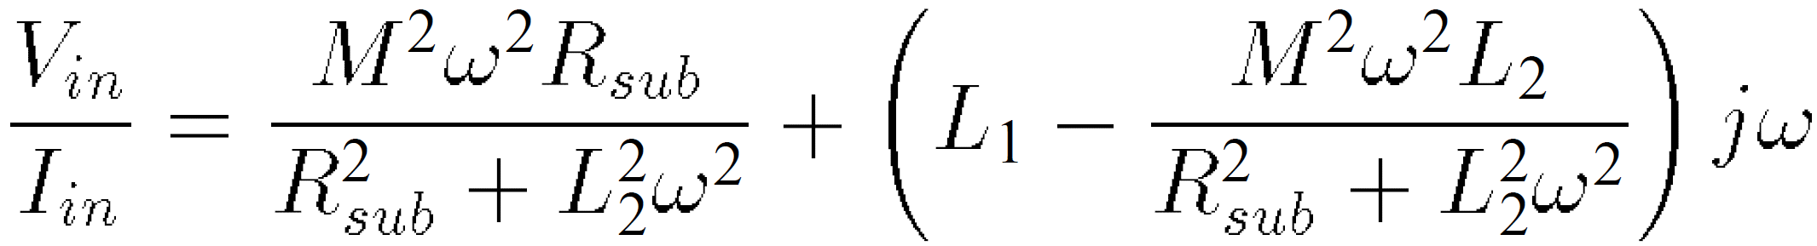
Modeling of Magnetic Coupling by Transformer
V_{in} = L₁sI_{in} + MsI₂
-R_{sub} I₂ = L₂I₂s + MsI_{in}
CH 7 Passive Devices

Slide 21
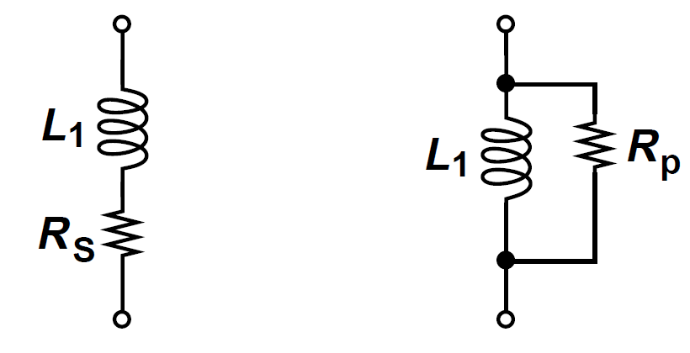
Modeling Loss by Series or Parallel Resistor
Q = L₁ ω/R_{s}
Q = R_{p} /L₁ ω
A constant series resistance R_{s} model inductor loss for limited range of frequencies.
A constant parallel resistance R_{p} model inductor loss for narrow range of frequencies.
Note --> The behavior of Q of inductor predicted by above two models has suggested opposite trends of Q with frequency.
CH 7 Passive Devices

Slide 22
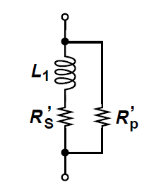
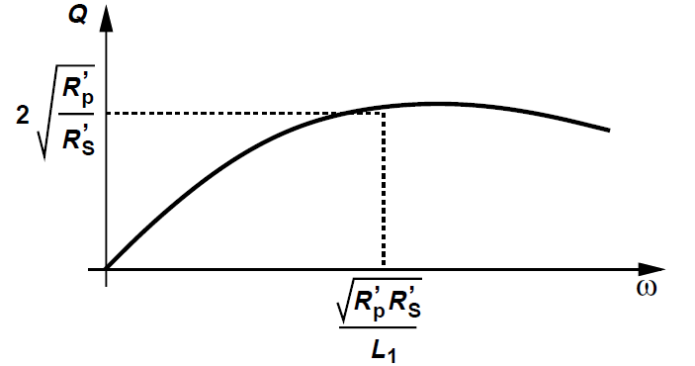
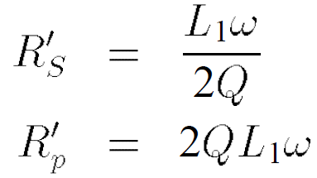
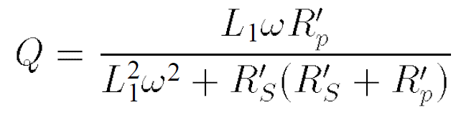
Modeling Loss by Both Series and Parallel Resistors
Modeling loss by both parallel and series resistances
Resulting behavior of Q
Overall Q of inductor
CH 7 Passive Devices

Slide 23
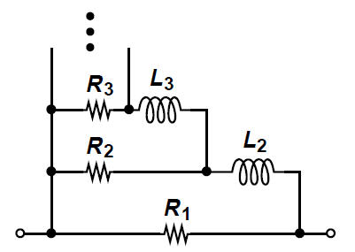
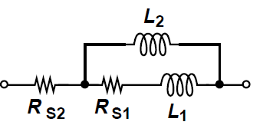
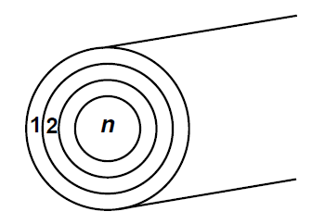
Broadband Model of Inductor
Broadband model
Broadband skin effect model
At low frequencies current is uniformly distributed thorough the conductor and model reduces to R₁||R₂||.....||R_{n} [9]
As frequency increases the current moves away from the center of the conductor, as modeled by rising impedance of inductors in each branch.
In [9], a constant ratio of R_{j}/R_{j+1} is maintained to simplify the model. ( L_{j} and R_{j} represents the impedance of cylinder j of conductor shown above)
CH 7 Passive Devices

Slide 24
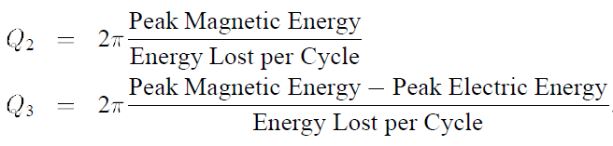

Definitions of Q
Reduce any resonant network to a parallel RLC tank,
Lumping all of the loss in a single parallel resistance Rp.
Define
CH 7 Passive Devices

Slide 25
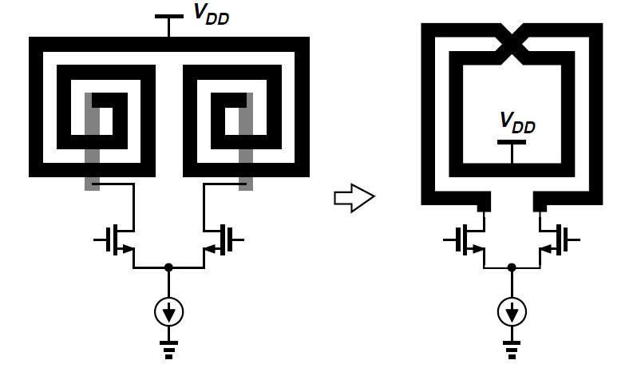
Symmetric Inductor
Differential circuits can employ a single symmetric inductor instead of two asymmetric inductors. It has two advantages:
1) Save area
2) Differential geometry also exhibit higher Q.
CH 7 Passive Devices

Slide 26
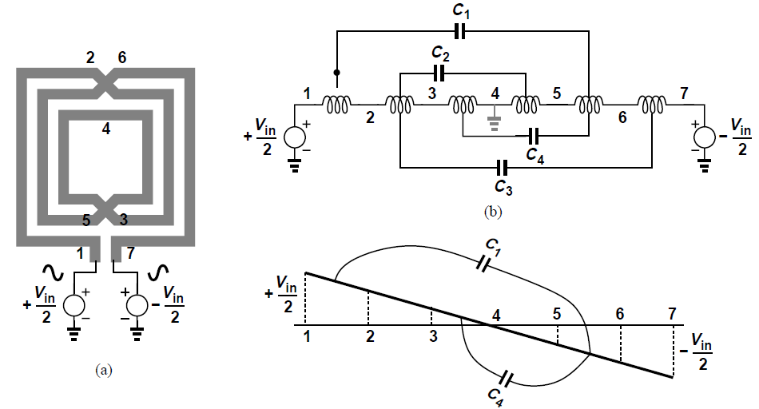
Equivalent Lumped Interwinding Capacitance
a) 3 turn symmetrical inductor (b) equivalent structure (c) Voltage profile
We unwind the structure as depicted above, assuming, an approximation, that all unit inductances are equal and so are all unit capacitances.
CH 7 Passive Devices

Slide 27
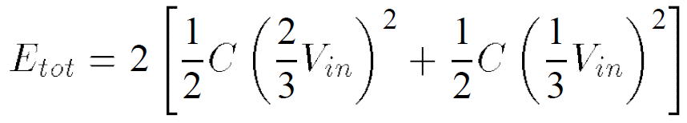
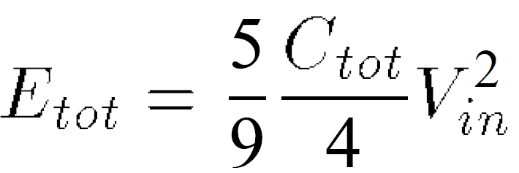

Equivalent Lumped Interwinding Capacitance
Total energy stored on the four capacitors is =
where C₁= C₂ = C₃ = C₄ .Denoting C₁+ C₂ + C₃ + C₄ = C_{tot} , we have
And hence equivalent lumped capacitance is:
Equivalent lumped interwiding capacitance of a symmetrical inductor is typically much larger than capacitance of substrate, dominating self resonance frequency.
CH 7 Passive Devices

Slide 28
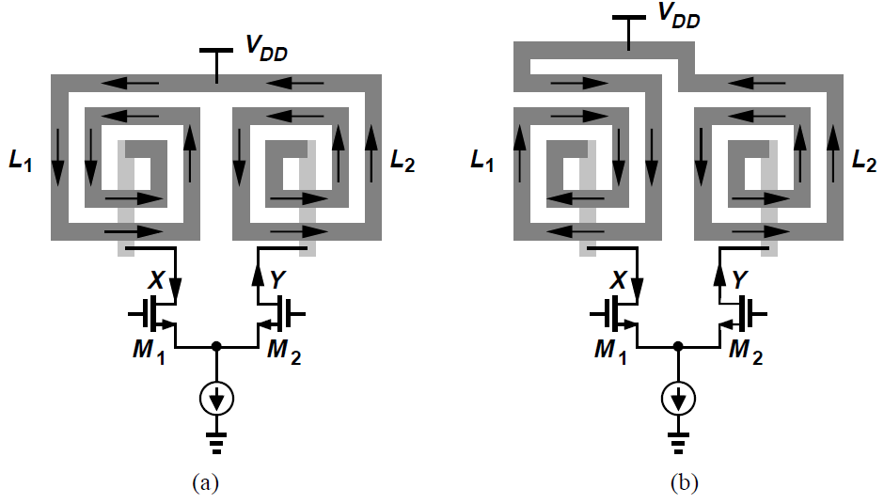
Mirror/Step Symmetry of Single Ended Inductor
Load inductors in a diff. pair with
(a) Mirror symmetry (b) Step symmetry
L_{eq} = L₁ + L₂ – 2M
Lower Q
L_{eq}= L₁ + L₂ + 2M
Higher Q
CH 7 Passive Devices

Slide 29
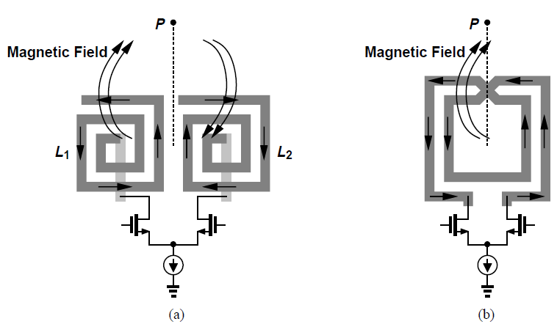
Magnetic Coupling Along Axis of Symmetry
(a) Single-ended inductor (b) Symmetric inductor
Differential spiral inductor produces a magnetic field on axis of symmetry.
No such coupling in case of two single ended inductors on axis of symmetry
CH 7 Passive Devices

Slide 30
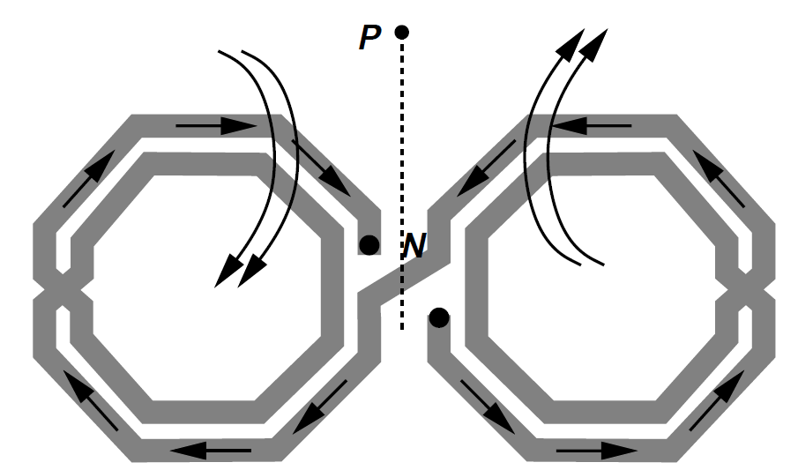
Example: Inductor with Reduced Magnetic Coupling Along Axis of Symmetry
The structure is more symmetric than single-ended spirals with step symmetry.
Magnetic field of two halves cancel on axis of symmetry
Have lower Q than differential inductor because each half experiences its own substrate losses.
CH 7 Passive Devices

Slide 31
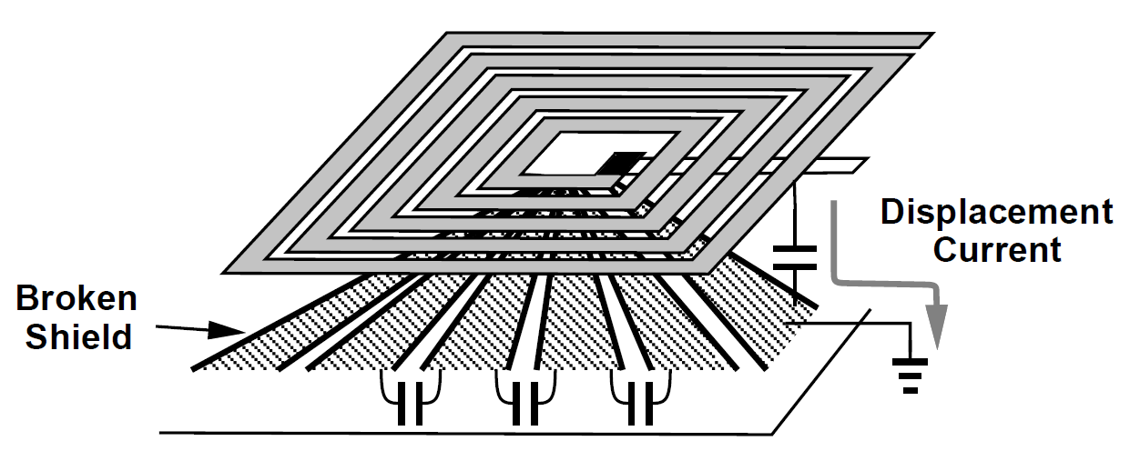
Inductors with Ground Shield
This structure allows the displacement current to flow through the low resistance path to ground to avoid electrical loss through substrate.
Eddy currents through a continuous shield drastically reduce inductance and Q, so a “patterned” shield is used.
This shield reduces the effect of capacitive coupling to substrate
Eddy currents of magnetic coupling still flows through substrate.
CH 7 Passive Devices

Slide 32
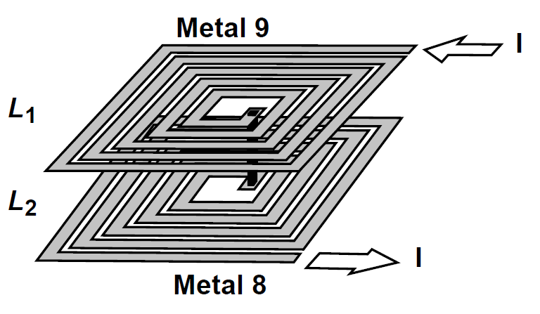
Stacked Inductors
L_{tot} = L₁ + L₂ + 2M M = L₁ = L₂
L_{tot} = 4L
Similarly, N stacked spiral inductor operating in series raises total inductance by a factor of N².
CH 7 Passive Devices

Slide 33
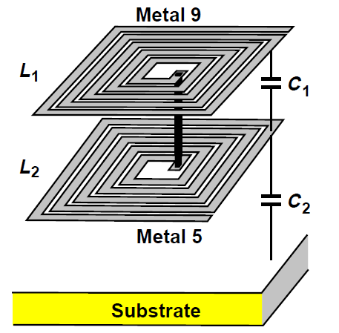
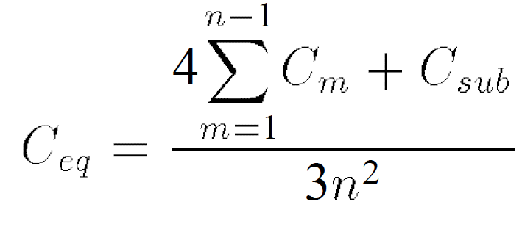
Equivalent Capacitance for a Stacked Inductor
C_{m} = inner spiral capacitances
In addition to substrate and interwinding capacitance it also contains another capacitance in between stacked spirals.
CH 7 Passive Devices

Slide 34
Transformers
Useful function of transformer in RF Design
Impedance matching
Feedback and feedforward with positive and negative polarity
Single ended to differential conversion and vice-verse.
AC coupling between stages
CH 7 Passive Devices

Slide 35
Characteristics of Well-Designed Transformers
Low series resistance in primary and secondary windings.
High magnetic coupling between primary and secondary windings.
Low capacitive coupling between primary and secondary windings.
Low parasitic capacitance to the substrate
CH 7 Passive Devices

Slide 36


Transformer Structures
Transformer derived from a symmetric inductor
Segments AB and CD are mutually coupled inductors.
Primary and secondary are identical so this is 1:1 transformer.
CH 7 Passive Devices

Slide 37



Simple Transformer Model and its Transfer Function
The transformer action gives
Solve above two equations for I₂
CH 7 Passive Devices

Slide 38


Simple Transformer Model and its Transfer Function
KCL at output node yields
Replacing I₂ in above equation and simplifying the result, we obtain
CH 7 Passive Devices

Slide 39


Input Impedance of Transformer Model with C_{F}=0
Setting C_{F} = 0 in above equation
Input/output transfer function =
Input Impedance =
CH 7 Passive Devices

Slide 40


Transformer with Turn Ratio More than Unity
Weaker mutual coupling factor
Stronger mutual coupling factor
CH 7 Passive Devices

Slide 41

Stacked Transformers
One to One Stack transformer
One to two Stack transformer
Staggering of turns to reduce capacitive coupling
Higher magnetic coupling.
Unlike planar structures, primary and secondary can be identical and symmetrical.
Overall area is less than planar structure
Larger capacitive coupling compared to planar structure.
CH 7 Passive Devices

Slide 42

Effect of Coupling Capacitance
Transfer function of transformer at s = jω:
For M>0, frequency response exhibit notch at ω Hz.
For M<0, no such notch exist and transformer can work at higher frequency.
So “non-inverting” transformer suffers from lower speed than “inverting” transformer.
CH 7 Passive Devices

Slide 43

Transformer Modeling
Due to the complexity of this model it is very difficult to find the values of each component from measurement or field simulations.
CH 7 Passive Devices

Slide 44

T-Line as Inductor
T-Line serving as load inductor
T-Line having short circuit termination act as an inductor (if T-line is much smaller than the wavelength of signal).
CH 7 Passive Devices

Slide 45


T-Line as Impedance Transformer
T-Line of length d, terminated with a load impedance of Z_{L} exhibit input impedance = Z_{in}(d).
β=2π/λ
, Z₀ = Characteristic impedance
Example at d= λ/4 then
i.e. a capacitive load transforms to inductive component.
CH 7 Passive Devices

Slide 46

T-Line Structures: Microstrip
In microstrip structure, signal line realized in top-most metal layer and ground plane is in lower metal layer. Hence have minimum interaction between signal line and substrate.
CH 7 Passive Devices

Slide 47


Characteristic Impedance of Micristrips
Characteristic impedance of microstrip, of signal line thickness 't' and height 'h' with respect to ground plane, is.
Note -> Above equation predict characteristic impedance with a large error (as large as 10%).
CH 7 Passive Devices

Slide 48




'Q' of Lossy T-Line
CH 7 Passive Devices

Slide 49

T-Line Structures: Coplanar Lines
The characteristic impedance of the coplanar structure is higher than that of the microstrip because
1) Thickness of signal and ground lines are quite small, leading to lower capacitance.
2) Spacing between two lines can be small, further decreasing the capacitance.
CH 7 Passive Devices

Slide 50

T-Line Structures: Stripline
Stripline structure consists of a signal line surrounded by ground planes.
It produces very little field leakage to surroundings.
The characteristic impedance of the stripline is smaller than both microstrip and coplanar structures.
CH 7 Passive Devices

Slide 51
Varactors
Varactor is a voltage-dependent capacitor.
Two important attributes of varactor design become critical in oscillator design
The capacitance range i.e. ratio of maximum to minimum capacitance that varactor can provide.
The quality factor of the varactor.
CH 7 Passive Devices

Slide 52


PN Junction Varactor
C_{jo} = Capacitance at zero bias
Vo = Built-in potential.
m = exponent around 0.3 in integrated structure
Varactor capacitance of reversed-biased PN junction.
Note - Weak dependance of C_{j} upon V_{d}, because
(V_{d,max} = 1V ) C_{j,max}/C_{j,min} ~ 1.23 (Low range) .
CH 7 Passive Devices

Slide 53

Varactor Q Calculation Issues
Q of varactor is obtained by measurement on fabricated structure
Difficult to calculate it
Current distribution in varactor
As shown above, due to the two dimensional flow of current it is difficult to compute the equivalent series resistance of the structure.
N-well sheet resistance can not be directly applied to calculation of varactor series resistance.
CH 7 Passive Devices

Slide 54

MOS Varactor ?
Regular MOS device:
Variation of gate capacitance with Vgs
A regular MOSFET exhibits a voltage dependent gate capacitance
The non-monotonic behavior with respect to gate voltage limits the design flexibility.
CH 7 Passive Devices

Slide 55


Accumulation Mode MOS Varactor
Accumulation-mode MOS varactor is obtained by placing an NMOS inside an nwell .
The variation of capacitance with Vgs is monotonic.
The C/V characteristics scale well with scaling in technology.
Unlike PN junction varactor this structure can operate with positive and negative bias so as to provide maximum tuning range.
C/V characteristics of varactor
CH 7 Passive Devices

Slide 56


Accumulation Mode MOS Varactor Operation
Vg < Vs
Depletion region is formed under gate oxide.
Equivalent capacitance is the series combination of gate capacitance and depletion capacitance.
Vg > Vs
Formation of channel under gate oxide.
CH 7 Passive Devices

Slide 57

Accumulation Mode MOS Varactor: Curve Fitting Model
Curve fitting model:
Here, “V_{o}” and “a” allow fitting for the slope and the intercept.
The above varactor model translates to different characteristics in different circuit simulators.
Simulation tools (HSPICE) that analyze circuits in terms of voltages and currents interpret the above non-linear capacitance equation correctly.
CH 7 Passive Devices

Slide 58

Accumulation Mode MOS Varactor: Charge Equation Model
Charge equation model:
Simulation tools ( Cadence Spectre) that represent the behavior of capacitors by charge equations interpret this charge equation model correctly.
CH 7 Passive Devices

Slide 59


Q of Accumulation mode MOS Varactor
Q of varactor:
Determined by the resistance between source and drain terminals.
Approximately calculated by lumped model shown in above.
CH 7 Passive Devices

Slide 60


Calculation of Equivalent Resistance and Capacitance Value in Lumped Model.
`
Distributed Model
Equivalent structure for half circuit
Canonical T-line Structure
The equivalent structure above resembles a transmission line consisting of series resistances and parallel capacitances. For general T-line structure the input impedance is :
CH 7 Passive Devices

Slide 61


Calculation of Equivalent Resistance and Capacitance Value in Lumped Model
Where Z₁ and Y₁ are specified for unit length and d is the length of line and from above equivalent structure Z₁d=R_{tot} and Y₁d=sC_{tot}.
At frequencies well below 1/(R_{tot}C_{tot} /4), the argument of tanh is much less than unity, allowing the approximation,
tanh ε = ε – ε³/3
= ε /(1+ ε ²/3)
It follows that
The lumped model of half of the structure consists of its distributed capacitance in series with 1/3 of its distributed resistance. Accounting for the gray half in equivalent circuit of half structure, we obtain
CH 7 Passive Devices

Slide 62

Variation of MOS Varactor Q with Capacitance
Variation of varactor Q with capacitance
For Cmin, the capacitance is small and resistance is large.
For Cmax, the capacitance is large and resistance is small.
Above comments suggest that Q remains relatively constant.
In practice, Q drops as we increase cap from Cmin to Cmax, suggesting that relative rise in capacitance is greater than fall in resistance.
CH 7 Passive Devices

Slide 63

Effect of Overlap Capacitance on Capacitance Range
Overlap capacitance is relatively voltage independent.
Overlap capacitance shifts the C/V characteristics up, yielding a ratio of
(C_{max} + 2WC_{ov})/(C_{min} + 2WC_{ov})
CH 7 Passive Devices

Slide 64
Constant Capacitors
RF circuits employ constant capacitors for various purposes:
To adjust the resonance frequency of LC tanks.
To provide coupling between stages.
To bypass the supply rail to ground.
Critical parameters of capacitors used in RF IC design:
Capacitance density.
Parasitic capacitance.
Q of the capacitor.
CH 7 Passive Devices

Slide 65


MOS Capacitor: Usage Examples
MOS capacitor used as coupling device.
MOS capacitor used as bypass capacitor
CH 7 Passive Devices

Slide 66




MOS Capacitor: Layout
MOS capacitor realized as
one long finger having resistance
MOS capacitor realized as
multiple short fingers having
resistance:
CH 7 Passive Devices

Slide 67

Metal Plate Capacitor
Parallel plate capacitor.
This structure employs planes in different metal layers.
CH 7 Passive Devices

Slide 68

Metal Plate Capacitor: Bottom Plate Parasitic
Parallel plate capacitor geometry suffers from bottom plate parasitic capacitance.
This capacitance reaches upto 10% of actual capacitance, leading to serious difficulty in circuit design
CH 7 Passive Devices

Slide 69

Fringe Capacitor
Fringe capacitor consists of narrow metal lines with minimum spacing.
The lateral electric field between adjacent metal lines leads to a high capacitance density.
CH 7 Passive Devices

Slide 70


References
CH 7 Passive Devices

Slide 71


References
CH 7 Passive Devices

Slide 72


References
CH 7 Passive Devices

